Slide 1

Name Navigator
Our goal is to achieve cultural awareness by accurately capturing and respecting the nuances of sensitive names.

Slide 2

Why Name Navigator ?
Create a Sense of Belonging for Clients
Our add-on enables customer service agents to address clients by their personalized names.
Foster Individuality
By considering clients' locales (language and country), we learn and respect each individual's culture and uniqueness.
Build Trust
People feel more secure and trusted when they can relate to someone or something. Name Navigator facilitates this by allowing client agents to use clients' local contexts appropriately.

Slide 3
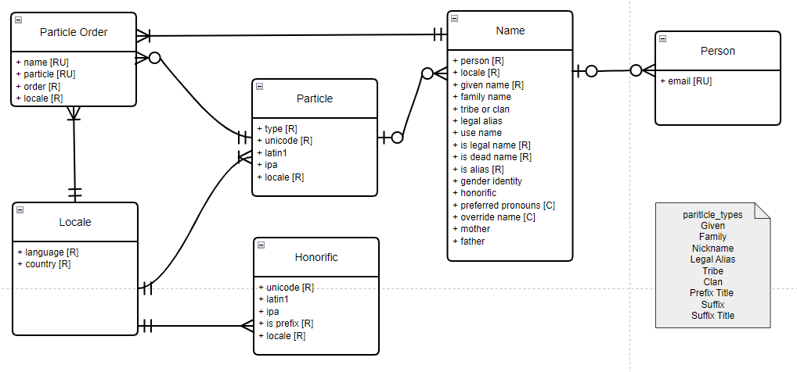
Conceptual model
The bottom right shows the conceptual model used to create the Name Navigator database.
This model illustrates the entities—Name, Particle Order, Particle, Locale, Honorific, and Person—representing the tables and their relationships that form the foundation of the database.
Particle – In the context of this database application, a particle refers to an individual component of a person's full name, specific to the chosen locale (language and country combination).
Particle Order – In the context of this database application, a particle order refers to the order of all particles making up the full component of a name.

Slide 4
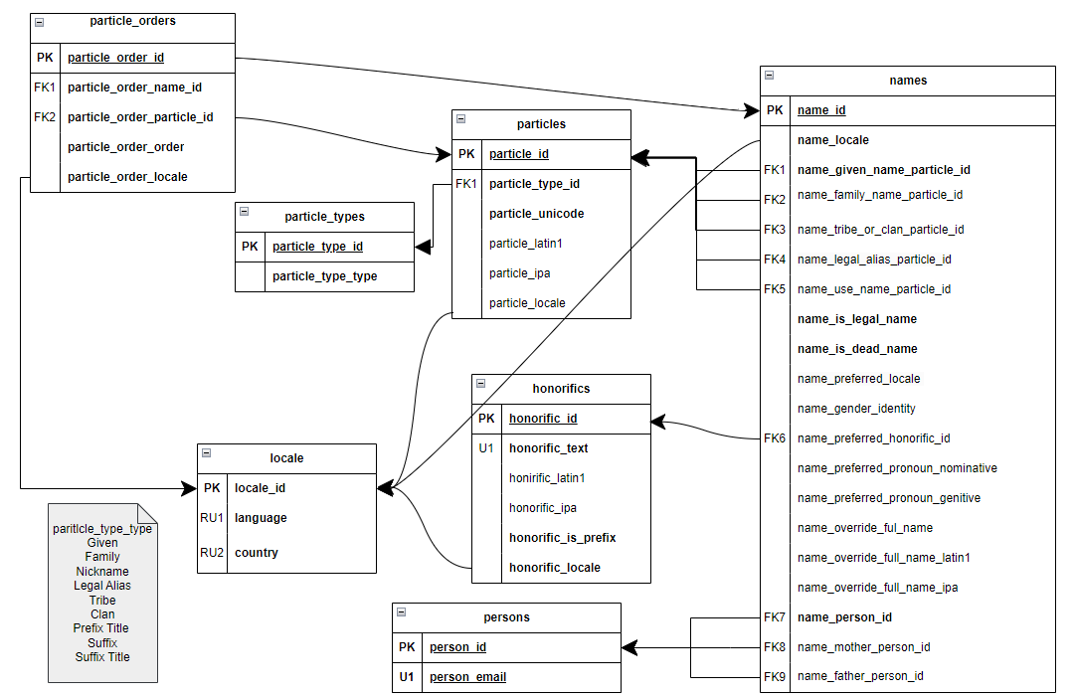
Logical model

Slide 5
User Journey
Account Manager
Customer's information
Customer service agents
Collects
Utilized
Account Manager: Collects the client's information and inputs it into the CRM software
Customer: Provides all components of their identity, including name, email, and phone number.
Agents: Utilize Name Navigator to properly address clients through phone calls, emails, or legal documents.

Slide 6
Database queries
1.) How many contacts (unique persons) in the database (eng_us locale)?
used to track growth of the system
2.) Show preferred names vs. active full name (eng_us locale)?
Who are the contacts/clients in the system
used to ensure preferred naming preferences are understood in account interactions
3.) Show use name vs. non-dead legal name for clients How many legal vs. non legal names?
used to ensure legal names are used for formal documentation, agreements, etc.
4.) Show preferred names and emails
How should we address contacts/clients for email marketing and system personalization?
5.) Show full name associated with email addresses
How should we address contacts/clients for formal communications and engagements requiring introductions?

Slide 7
Database queries cont'd
6.) Show legal name associated with an email address.
How should we address contacts/clients in formal legal documentation?
7.) Show the full set of unique email addresses (eng_us locale).
reviewed for data maintenance, data cleansing, and GDPR legal compliance
8.) Show all dead names (eng_us locale)
this list can be reviewed to ensure all communications and touch points with the person avoids the use of the dead name
9.) How many records lack a particle IPA?
used for data maintenance and cleansing. A linguist would use this query to find records to update.
future versions of the application could integrate with an ipa service and auto-populate these records
10.) Getting average amount of particles per name
used to determine if the system is being used as intended.
can be used as a metric for marketing teams that maintain a % Complete for IPA entries to ensure the particles being entered assist the team in properly personalizing interactions with clients.

Slide 8
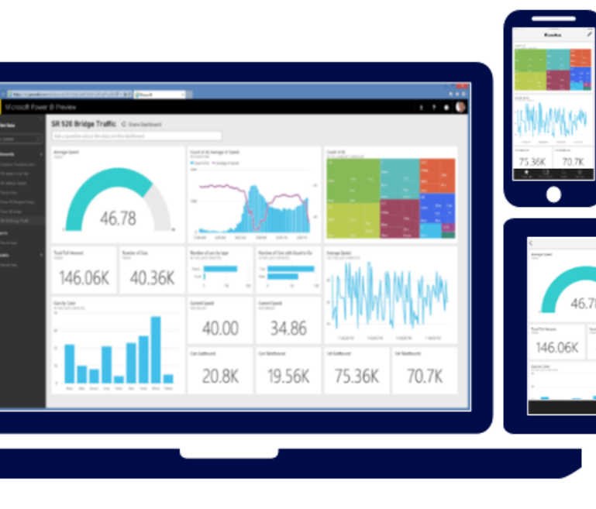
Reporting Visualization
1. Customer Distribution by Locality vs. Customer Agent Allocation
Description: This KPI visualizes the number of customers in each locality compared to the number of customer agents representing each locality.
Benefits: It aids account managers and hiring teams in optimizing workforce allocation to enhance productivity by aligning the number of agents with the customer distribution.
2. Usage of the Override Feature
Description: This report compares the number of customers using the override feature against those who do not.
Benefits: It enables account managers to set goals for their customer agents based on override feature usage. Additionally, it provides insights into whether the overrides are customer-initiated or if agents frequently set it as a default, allowing for better understanding and control over this feature’s usage.

Slide 9

Target Audience
Our target audience includes companies and business professionals who utilize Customer Relationship Management (CRM) applications to manage and oversee their customer base.
This Photo by Unknown author is licensed under CC BY-SA-NC.

Slide 10
Reflection and Lessons Learned
We actively controlled scope to fit within our deadline
By starting and brainstorming ideas early we were able to pick a sufficient topic that we were all passionate about
By starting all the deliverables early and in parallel , we were able to delegate tasks evenly among the team.
By working on the conceptual and logical models together we were able to gain a great understanding about the structure of the project.
One lesson learned was on how to parse a list to stored procedure
We were able to use our diverse and individual creativity to achieve a complex and enriched database

Slide 11
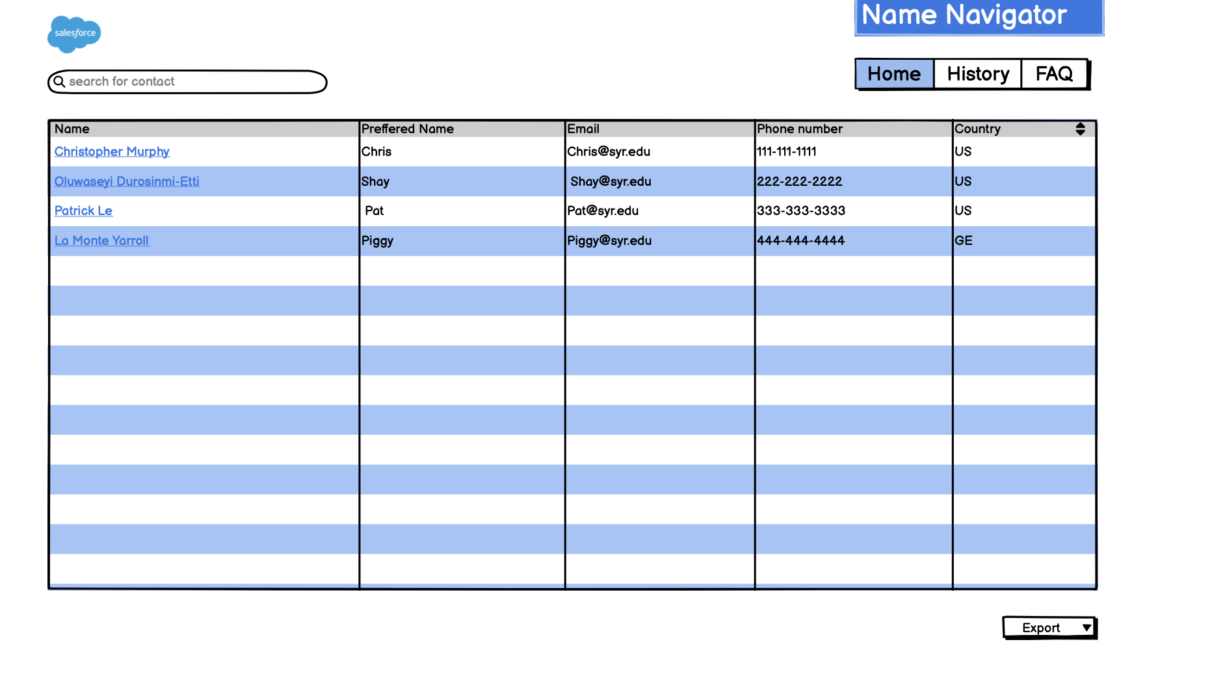
Databases Applications UI

Slide 12
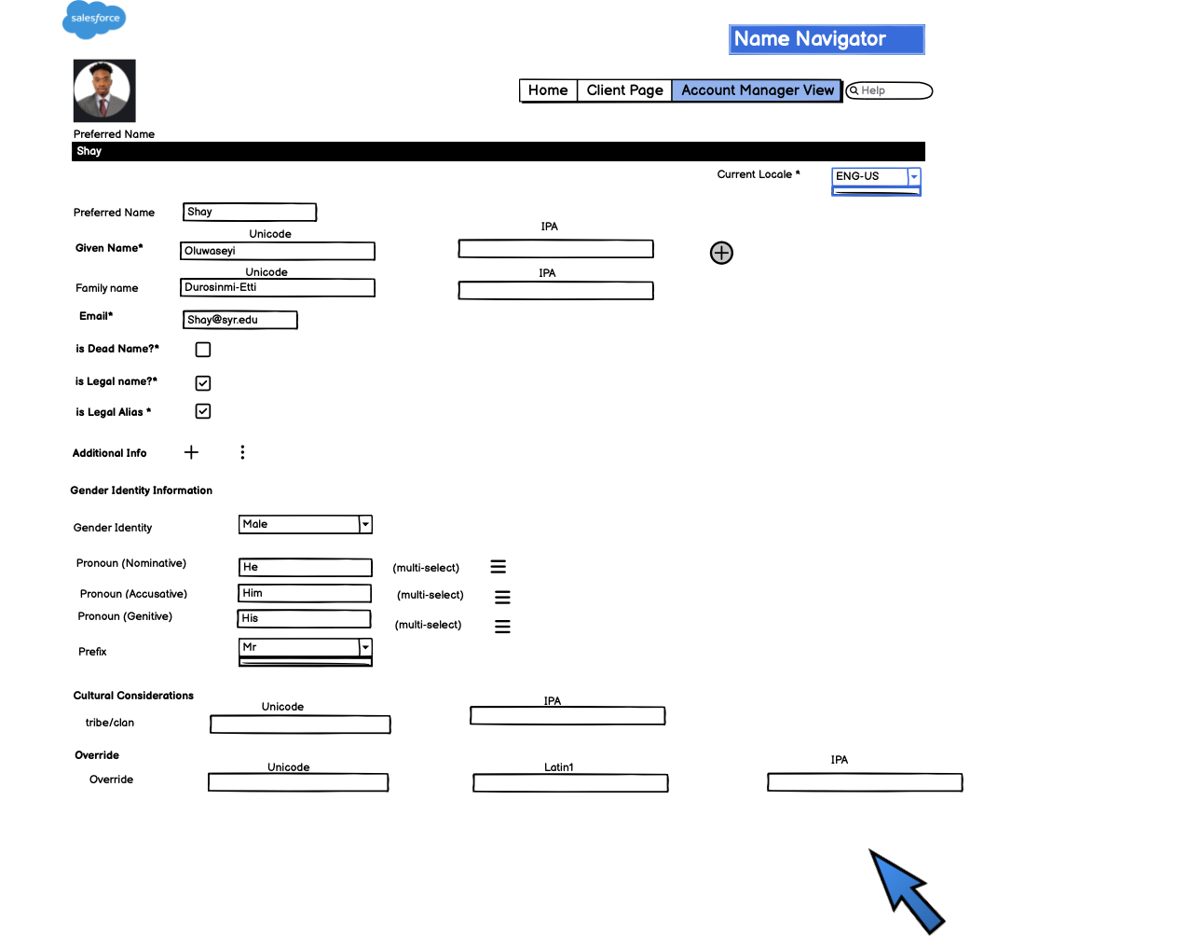
Databases Applications UI(Cont'd)

Slide 13
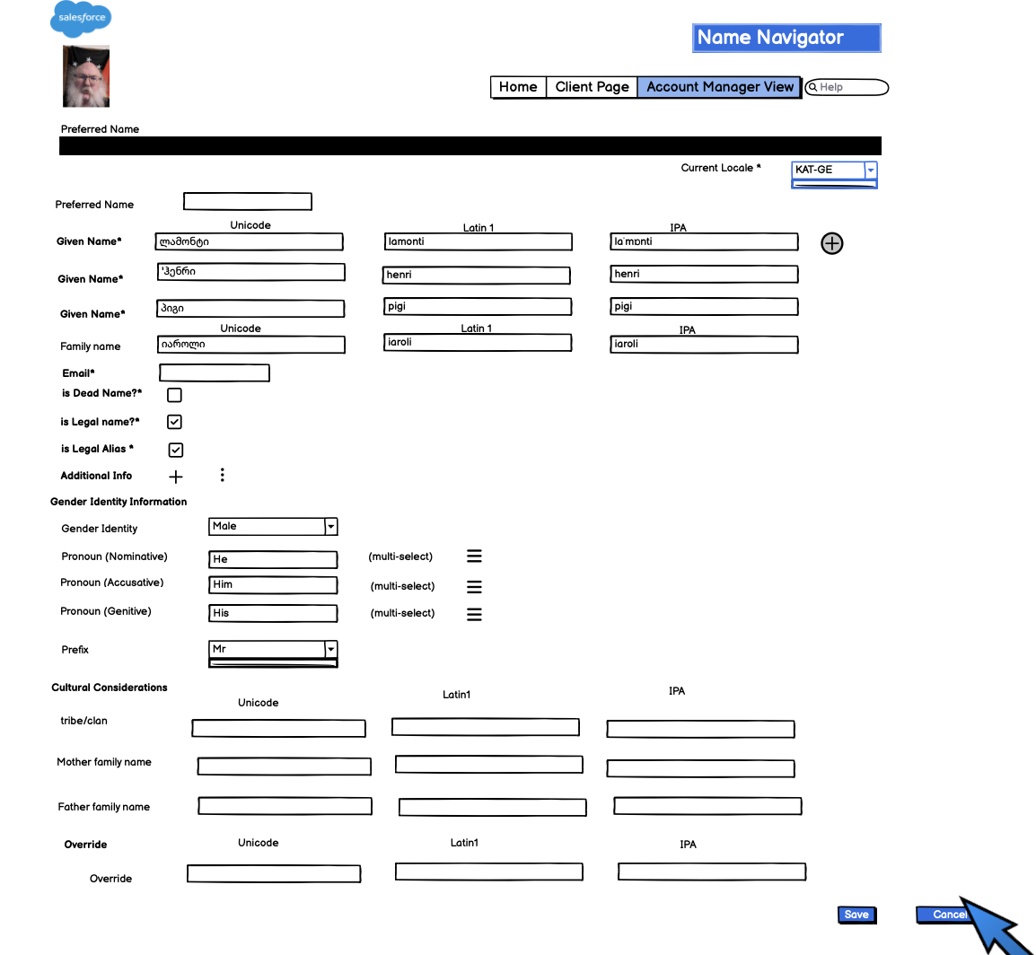
Databases Applications UI (Cont'd)

Slide 14
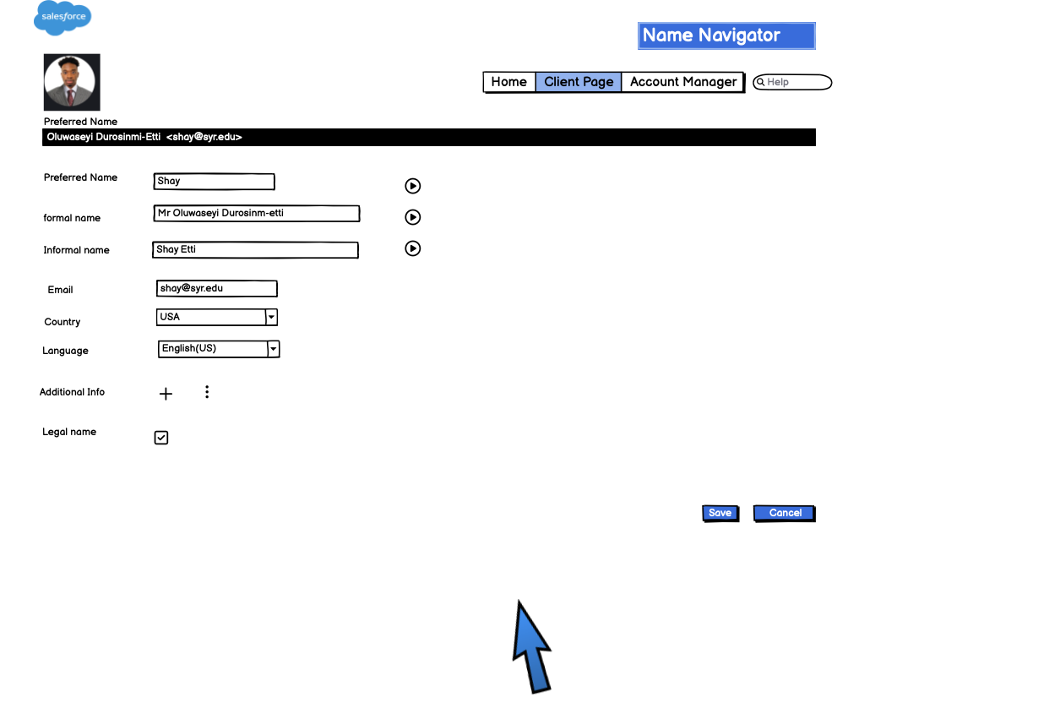
Databases Applications UI (Cont'd)

Slide 15




Conclusion
What's Our Purpose?
Our mission is to highlight the significance of people's names by accurately capturing their essence and pronunciation resulting to high customer satisfaction
What Does the Future Look Like?
We plan to integrate AI technology to assist Customer Service agents in correctly pronouncing names, enhancing personalized service.
With Machine Learning adaptability the use of neural network and deep learning can give the software adaptability to learn subtle patterns and strategies.

